Slide 1
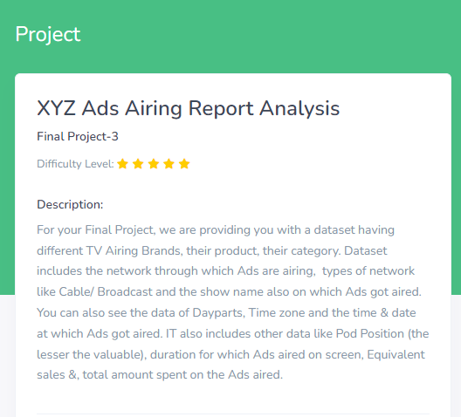

Slide 2
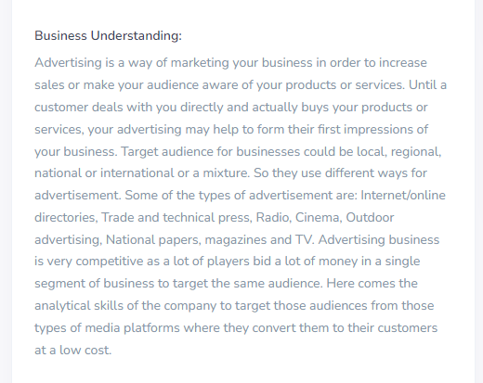

Slide 3
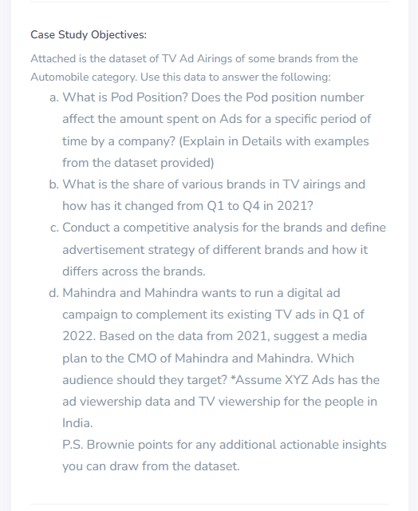

Slide 4
What is Pod Position?
Ad pod is a term used in connection with CTV advertising to specify multiple ads sequenced together and played back-to-back within a single ad break, like traditional linear TV. They allow publishers to return multiple ads from a single ad request, and then those ads are played in sequence.
The position of an individual advertisement within a certain commercial pod. The sequential location of an individual commercial within a pod. ( Source: Nielsen)
The ProofVision TV Pod is a large casing designed to house, protect and store your household TV either outdoors or indoors, coming in a variety of sizes to fit regular modern TVs.

Slide 5
Does the Pod position number affect the amount spent on Ads for a specific period of time by a company?
No, the Pod position number does not affect the amount spent on Ads for a specific period of time by a company because the Pod position is just the position of an individual advertisement within a certain commercial pod.
Ad pods are simply a group of ads shown in sequence within an ad break.
Similarly, advertisers have the opportunity to specify which position within an ad pod they prefer – whether that’s the first slot, the last slot, or somewhere in between
Here for example even if the Pod position is 11 or 1 the time spent$ or Hour of Days does not differs.

Slide 6
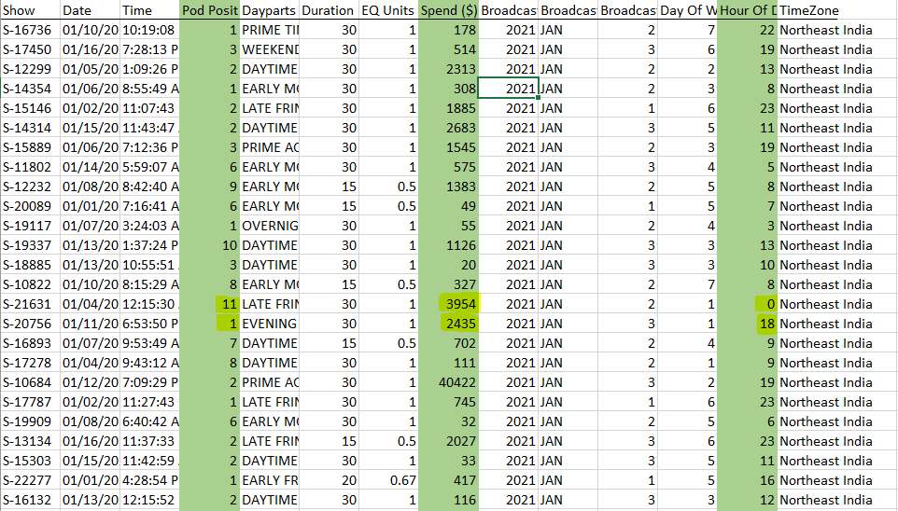

Slide 7
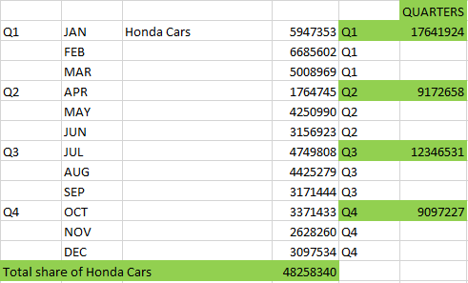
What is the share of various brands in TV airings and how has it changed from Q1 to Q4 in 2021?

Slide 8
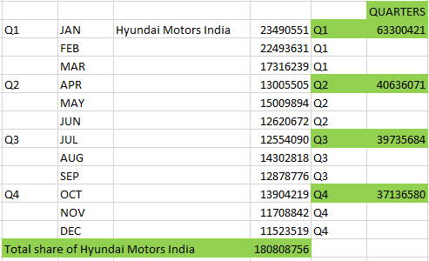

Slide 9


Slide 10
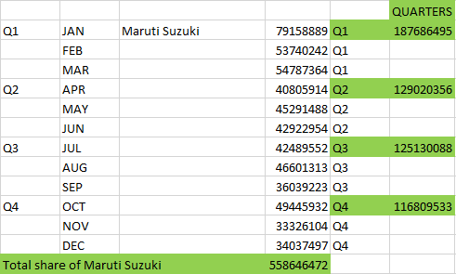

Slide 11
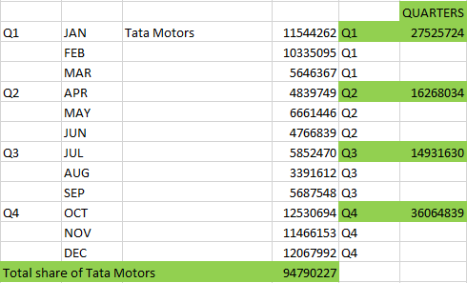

Slide 12
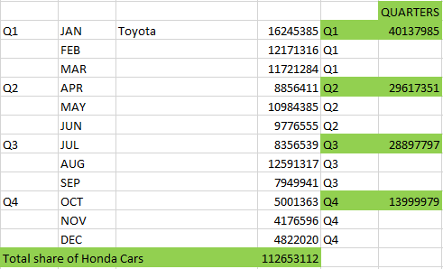

Slide 13
Conduct a competitive analysis for the brands and define advertisement strategy of different brands and how it differs across the brands.
There are three essential steps in competitor analysis: identifying your competitors, analyzing their customer journey, and reviewing their marketing strategies.
Identify Your Competitors.
Analyse Your Competitor’s Customer Journey.
Review Their Marketing Strategy.

Slide 15
Data analytics in advertising involves using data generated by websites, social channels, software applications, mobile devices, and third-party data sources to measure campaign performance and identify new opportunities for advertising initiatives. With data analytics, you can improve attribution, campaign optimization, and resource allocation.
Attribution: Improve attribution by tracking the customer journey and identifying each touchpoint that a customer encountered along the path to purchase. With a better understanding of how activities and channels worked together to nurture a customer, you can make more-informed decisions when planning future campaigns.
Campaign optimization: Optimize campaign performance by measuring and testing various elements of a campaign, including messaging, ad layout, and calls to action. With cohort analysis, you can uncover commonalities and patterns in customer behavior and use those insights to hone campaigns. “What-if” analysis can be used to evaluate likely outcomes of various actions so you can better identify how to improve campaigns.
Resource allocation: Analytics can reveal how to optimize resource allocation such as ad spend. You can determine which channels to invest more in and which to cut back on. You can also better identify what is likely to happen based on a variety of different variables and iterate accordingly. Additionally, analytics can help you reduce customer acquisition cost.

Slide 16
Comparative analysis of how each brands differs

Slide 17
According to the above bar chart,
Honda Cars have highest number of views on DAY TIME among Honda Cars and have lowest number of views on OVERNIGHT among Honda Cars by the audience.
Hyundai Motors India have highest number of views on PRIME TIME among Hyundai Motors India and have lowest number of views on OVERNIGHT among Hyundai Motors India by the audience.
Mahindra and Mahindra have highest number of views on PRIME TIME among Mahindra and Mahindra and have lowest number of views on OVERNIGHT among Mahindra and Mahindra by the audience.

Slide 18
Maruti Suzuki have highest number of views on PRIME TIME among Maruti Suzuki and have lowest number of views on OVERNIGHT among Maruti Suzuki by the audience. Maruti Suzuki is the only brand which have highest views by the audience on every dayparts(shows).
Tata Motors have highest number of views on PRIME TIME among Tata Motors and have lowest number of views on OVERNIGHT among Tata Motors by the audience.
Toyota have highest number of views on DAY TIME among Toyota and have lowest number of views on OVERNIGHT among Toyota and also among other brands by the audience.

Slide 19
Mahindra and Mahindra wants to run a digital ad campaign to complement its existing TV ads in Q1 of 2022
Mahindra & Mahindra’s campaign on Advertisement strategy
Mahindra & Mahindra do write blogs and listicles on their website to attract customers. It will be more beneficial for the people if this company starts making EVs.
Different affairs and challenges like the Dubsmash & win KUV100 contest are influenced on social media to create buzz and are customer-oriented.
It has all over 17 million fansacross different brands and over 40 million views onYouTube.
Mahindra & Mahindra also posted a video on YouTube of a car with a charming dashboard, engaging on the road, taking Varun Dhawan as a brand ambassador.

Slide 20
What’s Unique in Mahindra & Mahindra Marketing?
Mahindra & Mahindra is overall the best company amongst others. Will it be in terms of service, product, or any other things? The most amazing fact is that this brand didn’t only think of making Trucks but also Cars, Jeeps, Buses etc. to meet every individual’s demand.
Over many years now, Mahindra & Mahindra experiences a huge development in the innovation and technology of the cars. Their marketing strategies and skills are hitting millions of views and buys on the internet. And also because of the influence, they may start many more new industries soon as the revenue is hitting hard.
With the increasing importance of digital marketing, learning about the growing field is an important step. If you would like to learn more and develop skills, check out IIDE’s 4 Month Digital Marketing Course to learn more.
If you like such in-depth analysis of companies just like the marketing strategy of Mahindra and Mahindra, check out our IIDE Knowledge portal for more fascinating case studies.

Slide 22
Based on the data from 2021, suggest a media plan to the CMO of Mahindra and Mahindra. Which audience should they target?
According to the research from the given XYZ Ad company airing report dataset,
Maruti Suzuki brand has the highest audience support over every products of their brand also it is the leading brand among the TV Ads of the year 2021.
Mahindra & Mahindra has the 2nd highest audience support over every products of their brand and 2nd leading brand among the TV Ads of the year 2021. So the CEO of Mahindra & Mahindra(Anish Shah) wants to target the brand Maruti Suzuki.

